Slide 1
디지털시스템 및 마이크로 컴퓨터 I
6 주차 강의
인제대학교 의용공학부
조 종만 교수
Apr., 05, 2021

Slide 2
Part 1 Latches

Slide 3
Objectives
S-R and gated D latches
2. D, D-CE, S-R, J-K and T flip-flops
3. Characteristic (next-state) equations
4. Timing diagram
5. Construction analysis of latches and flip-flops using gates

Slide 4
Introduction
Logic Circuit
Combinational logic circuit
Sequential logic circuit: output depends on
Present input
Past sequence of inputs
Memory circuit
Feedback circuit

Slide 5
Introduction
An Inverter with Feedback
Unstable state
Two Inverters with Feedback
Stable state

Slide 6
Set-Reset Latch
Simple Latch
Two stable states and has memory function
S = R = 0 → Q = 0
S = 1, R = 0 → Q = 1
P
Q
P
Q
1
0
S
0
0
S
1
1
R
0
R
0
(a)
(b)
S = R = 0 → Q = 1
S = 0, R = 1 → Q = 0
P
P
Q
Q
0
1
0
S
0
1
S
0
R
0
R
1
(c)
(d)

Slide 7
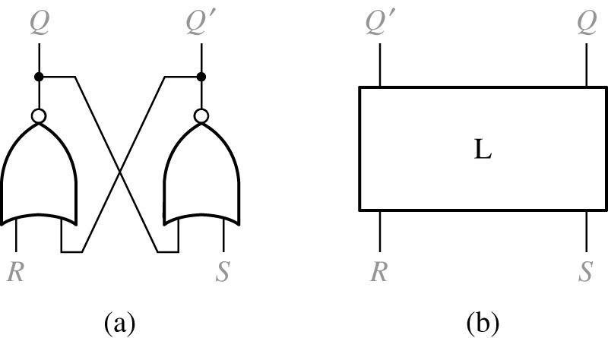
Set-Reset Latch
S-R Latch
S: Sets the output to Q=1
R: Resets the output to Q=0
S=R=1 is not allowed
Cross-coupled Form
Symbol
Q
Q’
Q’
Q
R
S
R
S

Slide 8
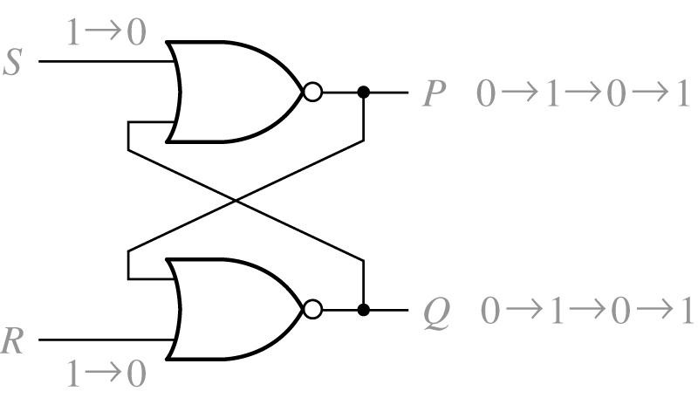
Set-Reset Latch
Improper S-R Latch Operation (S = R = 1 is prohibited)
1 → 0
S
P
0 → 1 → 0 → 1
Q
0 → 1 → 0 → 1
R
1 → 0
If S = R = 1, then
It violates the basic rule of latch operation.
It oscillates.

Slide 9
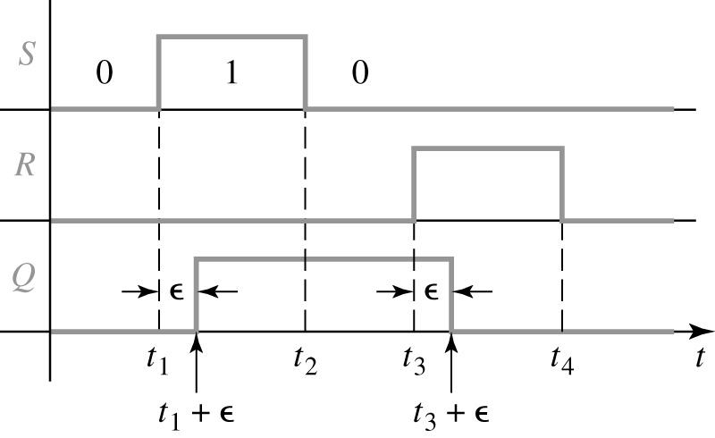
Set-Reset Latch
Timing Diagram for S-R Latch
S
ε: response time or delay time
R
Q

Slide 10
Set-Reset Latch
S-R Latch Operation
S(t) R(t) Q(t) | Q(t+ε)
0 0 0 0 0 1 0 1 0 0 1 1 1 0 0 1 0 1 1 1 0 1 1 1 | 0 1 0 0 1 1 - -
Q(t): Present state
Q(t+ ε): Next state
Inputs not allowed

Slide 11
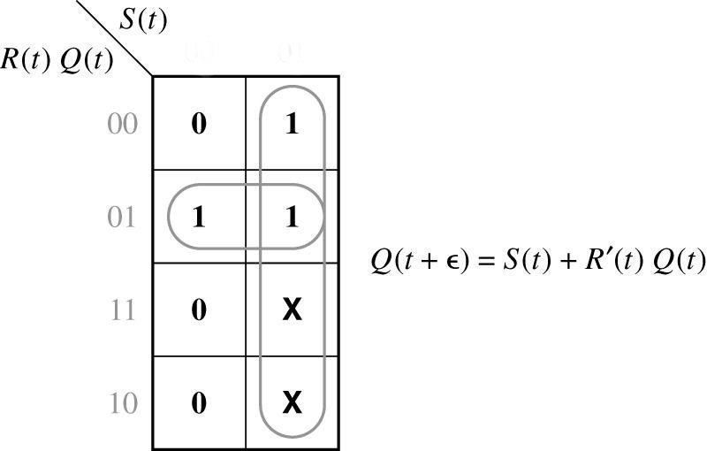
Set-Reset Latch
Characteristic Equation for S-R Latch
0
1
S(t) R(t) Q(t)
Q(t+ε)
00
0 0 0
0 0 1
0 1 0
0 1 1
1 0 0
1 0 1
1 1 0
1 1 1
0
1
0
0
1
1
-
-
01
11
$$Q^{+}=S+R^{′}Q \left(SR=0\right)$$
10

Slide 12
Set-Reset Latch
Application of an S-R Latch
Switch Debouncing with an S-R Latch
S
S
b
+V
1
R
a
Q
Q
R

Slide 13
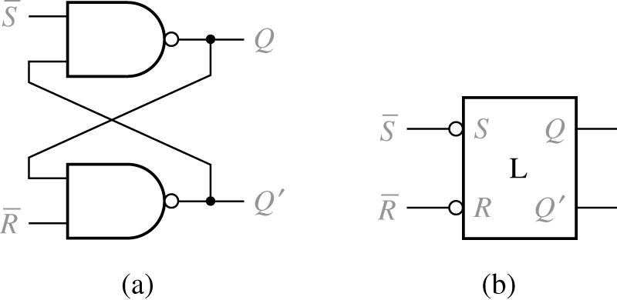
Set-Reset Latch
Alternative Form of the S-R Latch Using NAND Gates: Latch
$$\overline{S}−\overline{R}$$
S(t) R(t) Q(t)
Q(t+ε)
$$\overline{S}$$
$$Q$$
1 1 0
1 1 1
1 0 0
1 0 1
0 1 0
0 1 1
0 0 0
0 0 1
0
1
0
0
1
1
-
-
$$\overline{S}$$
S
$$Q$$
$$Q′$$
$$\overline{R}$$
R
$$Q′$$
$$\overline{R}$$

Slide 14
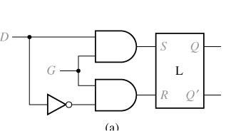
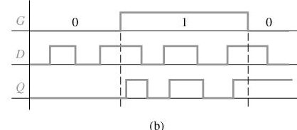
Gated D Latch
Gated D Latch
$$D$$
$$S$$
$$Q$$
$$G$$
$$R$$
$$Q′$$
Transparent Latch
$$G$$
$$D$$
$$Q$$

Slide 15
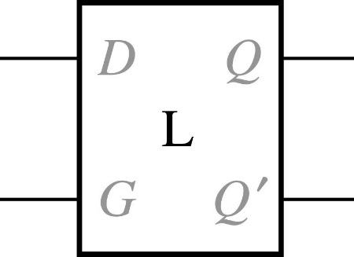
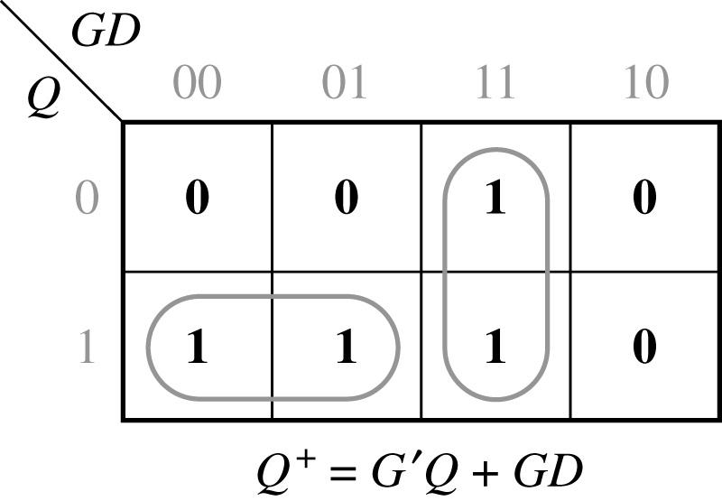
Gated D Latch
Symbol and Truth Table for Gated D Latch
$$Q$$
G D Q | Q⁺
0 0 0 0 0 1 0 1 0 0 1 1 1 0 0 1 0 1 1 1 0 1 1 1 | 0 1 0 1 0 0 1 1
$$D$$
$$G$$
$$Q′$$
00
01
11
10
0
1

Slide 16
Part 2 Flip-Flops

Slide 17
Edge-Triggered D Flip-Flop
Flip-Flop
Output changes only in response to the clock
Rising-edge (positive-edge) Triggered Flip-Flop
Output changes in response to a 0 to 1 transition on the clock
Falling-edge (negative-edge) Triggered Flip-Flop
Output changes in response to a 1 to 0 transition on the clock
Active Edge
Clock edge (rising or falling) that triggers the flip-flop

Slide 18
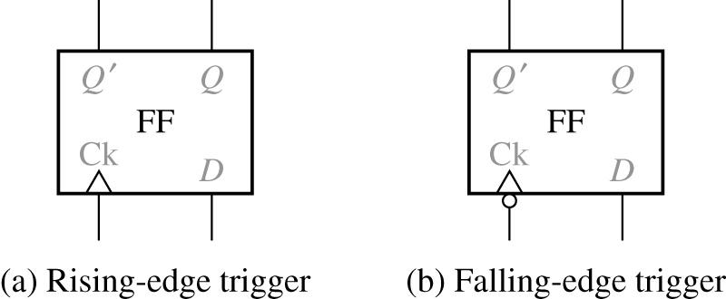
Edge-Triggered D Flip-Flop
D Flip-Flops
D Q | Q⁺
0 0 0 1 1 0 1 1 | 0 0 1 1
$$Q′$$
$$Q$$
$$Q′$$
$$Q$$
$$Q^{+}=D$$
$$Ck$$
$$D$$
$$Ck$$
$$D$$
Truth table
Timing for D Flip-Flop (Falling-Edge Trigger)
$$D$$
$$Ck$$
$$Q$$

Slide 19
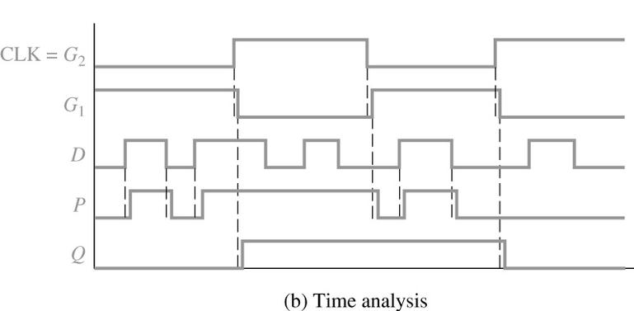
Edge-Triggered D Flip-Flop
D Flip-Flop (Rising-Edge Trigger)
$$P$$
$$D$$
$$Q$$
$$\text{CLK}$$
$$\text{CLK}\text{=}G_{2}$$
$$G_{1}$$
$$D$$
$$P$$
$$Q$$

Slide 20
Edge-Triggered D Flip-Flop
Setup and Hold Times for an Edge-Triggered D Flip-Flop
$$D$$
$$\text{CLK}$$
$$Q$$
$$t_{su}:\text{setup} \text{time} \\ t_{h}:\text{hold} \text{time} \\ t_{p}:\text{propagation} \text{delay}$$

Slide 21
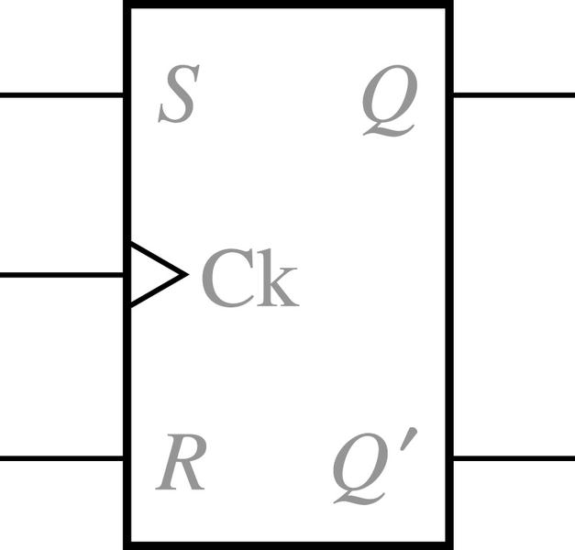
S-R Flip-Flop
S-R Flip-Flop
$$S$$
$$Q$$
$$Ck$$
$$R$$
$$Q′$$
Operation Summary
S=R=0 no state change
S=1, R=0 set Q to 1 (after active Ck edge)
S=0, R=1 reset Q to 0 (after active Ck edge)
S=R=1 not allowed

Slide 22
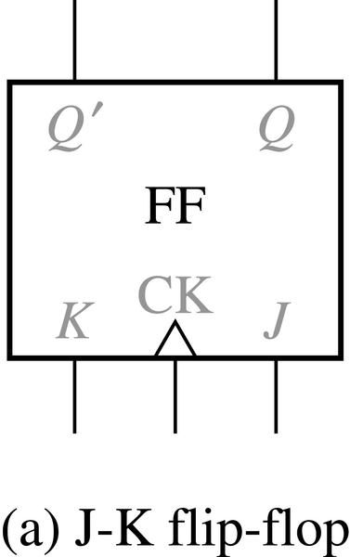
J-K Flip-Flop
J-K Flip-Flop (Rising Edge Trigger Type)
J K Q | Q⁺
0 0 0 0 0 1 0 1 0 0 1 1 1 0 0 1 0 1 1 1 0 1 1 1 | 0 1 0 0 1 1 1 0
$$Q′$$
$$Q$$
$$K$$
$$CK$$
$$J$$
$$Q^{+}=JQ^{′}+K^{′}Q$$
Next state table and characteristic equation

Slide 23
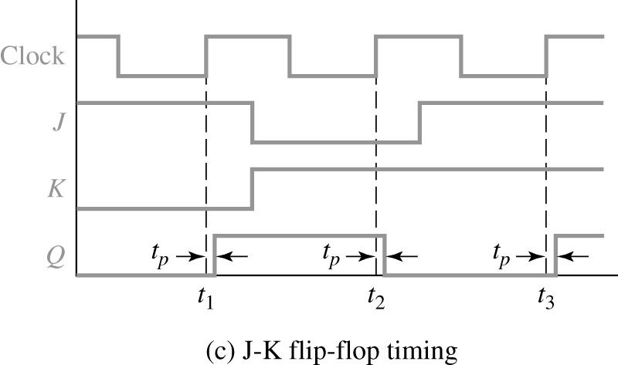
J-K Flip-Flop
J-K Flip-Flop (Timing Chart)
J K Q | Q⁺
0 0 0 0 0 1 0 1 0 0 1 1 1 0 0 1 0 1 1 1 0 1 1 1 | 0 1 0 0 1 1 1 0
$$Clock$$
$$J$$
$$K$$
$$Q$$

Slide 24
J-K Flip-Flop
Master-Slave J-K Flip-Flop (Rising Edge Trigger Type)
$$J$$
$$Q$$
$$CLK$$
$$K$$
$$Q′$$

Slide 25
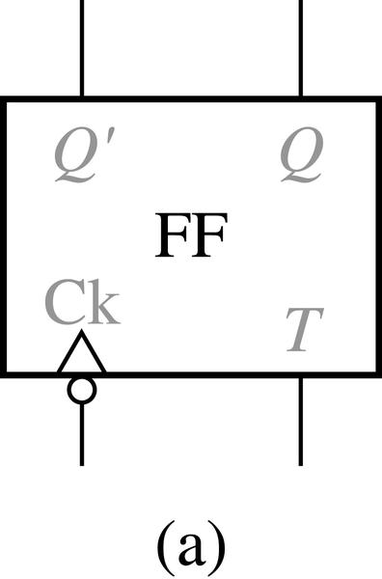
T Flip-Flop
T Flip-Flop
T Q | Q⁺
0 0 0 1 1 0 1 1 | 0 1 1 0
$$Q′$$
$$Q$$
$$Ck$$
$$Q^{+}=T^{′}Q+TQ^{′}=T⊕Q$$
$$T$$

Slide 26
T Flip-Flop
Timing Diagram for T Flip-Flop (Falling-Edge Trigger)
T Q | Q⁺
0 0 0 1 1 0 1 1 | 0 1 1 0
$$Q′$$
$$Q$$
$$Ck$$
$$T$$
$$Ck$$
$$T$$
$$Q$$

Slide 27
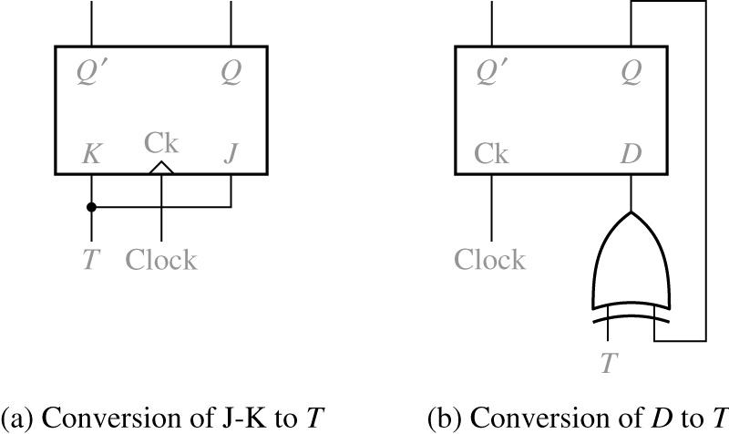
T Flip-Flop
Implementation of T Flip-Flop
$$Q′$$
$$Q$$
$$Q′$$
$$Q$$
$$K$$
$$Ck$$
$$J$$
$$Ck$$
$$D$$
$$T$$
$$Clock$$
$$Clock$$
$$Q^{+}=JQ^{′}+K^{′}Q=TQ^{′}+T^{′}Q$$
$$T$$

Slide 28
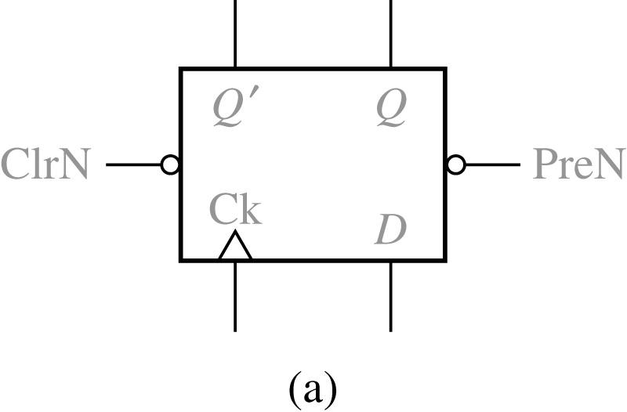
Flip-Flops with Additional Inputs
D Flip-Flop with Asynchronous Clear and Preset Inputs
Ck D PreN ClrN | Q+
x x 0 0 x x 0 1 x x 1 0 ↑ 0 1 1 ↑ 1 1 1 0,1,↓ x 1 1 | (not allowed) 1 0 0 1 Q(no charge)
$$Q′$$
$$Q$$
$$ClrN$$
$$PreN$$
$$Ck$$
$$D$$

Slide 29
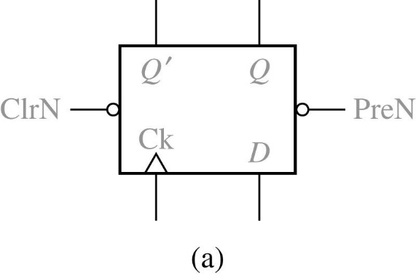
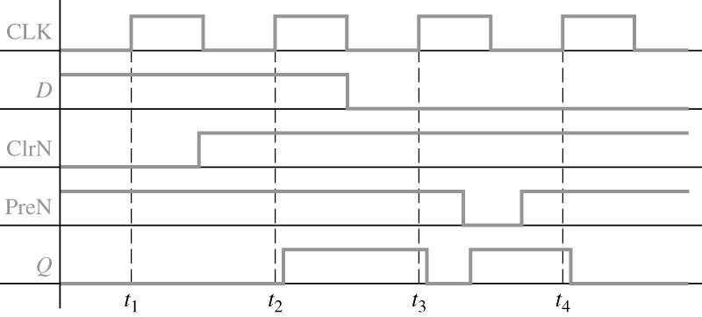
Flip-Flops with Additional Inputs
Timing Diagram for D Flip-Flop with Asynchronous Clear and Preset
$$Q′$$
$$Q$$
$$ClrN$$
$$PreN$$
$$Ck$$
$$D$$
$$CLK$$
$$D$$
$$ClrN$$
$$PreN$$
$$Q$$

Slide 30
Flip-Flops with Additional Inputs
D Flip-Flop with Clock Enable
$$D$$
$$Q$$
$$D$$
$$Q$$
$$1$$
$$0$$
$$D$$
$$Q$$
$$D_{in}$$
$$CE$$
$$CE$$
$$CLK$$
$$Ck$$
$$Q′$$
$$Ck$$
$$Q′$$
$$CLK$$
$$Ck$$
$$Q′$$
$$En$$
(may result in loss of synchronization)
(ideal synchronization)
The characteristic equation :
$$Q^{+}=Q⋅CE^{′}+D⋅CE$$
The MUX output :
$$Q^{+}=D=Q⋅CE^{′}+D_{in}⋅CE$$

Slide 31
Summary
Characteristic Equations
$$Q^{+}=S+R^{′}Q \left(SR=0\right)$$
(S-R latch or flip-flop)
$$Q^{+}=GD+G^{′}Q$$
(gated D latch)
$$Q^{+}=D$$
(D flip-flop)
$$Q^{+}=D⋅CE+Q⋅CE^{′}$$
(D-CE flip-flop)
$$Q^{+}=JQ^{′}+K^{′}Q$$
(J-K flip-flop)
$$Q^{+}=T⊕Q=T^{′}Q+TQ^{′}$$
(T flip-flop)

